Slide 1
Acknowledgement
This material of Logic Design is a derivative copy of Kann, Charles W., "Digital Circuit Projects: An Overview of Digital Circuits Through Implementing Integrated Circuits - Second Edition". Gettysburg College Open Educational Resources. licensed under Creative Commons Attribution License 4.0 license, Introduction to Digital Logic with Laboratory Exercises by James Feher under Creative Commons Attribution License 3.0 license and Digital Logic Design by A.F Kana.

Slide 2
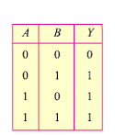

OR Gate
The output Y of an OR gate is LOW when all inputs are LOW.
The output Y of an OR gate is HIGH if any or all the inputs are HIGH
The logic symbol, Boolean expression and truth table of a two input OR gate will look like this:
Y=A+B

Slide 3
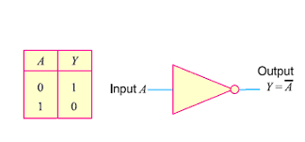
NOT Gate or Inverter
It has only one input and one output , the output is opposite of the input.

Slide 4
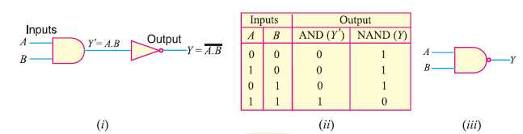
COMBINATION OF BASIC LOGIC GATES
NAND Gate
It is a combination of AND gate and NOT gate.
The output of a NAND gate is opposite to the AND gate.

Slide 5
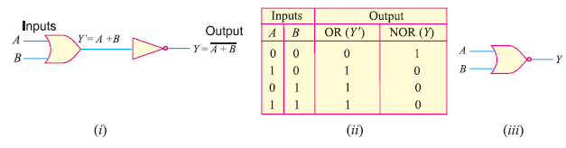
NOR Gate
It is a Combination of OR gate and NOT gate.
The output of a NOR gate is opposite to the OR gate.

Slide 6
Universal Gates (NAND & NOR)
Session No. 2
A universal gate is a gate which can implement any Boolean function without need to use any other gate type. The NAND and NOR gates are called universal gates.
In practice, this is advantageous since NAND and NOR gates are economical and easier to fabricate and are the basic gates used in all IC digital logic families.
In fact, an AND gate is typically implemented as a NAND gate followed by an inverter not the other way around!!
Likewise, an OR gate is typically implemented as a NOR gate followed by an inverter not the other way around!!

Slide 7
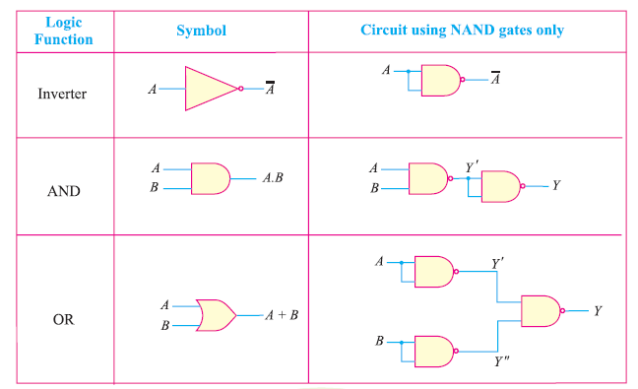
NAND Gate as a Universal Gate

Slide 8
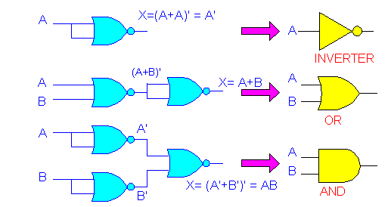
NOR Gate as a Universal Gate

Slide 9
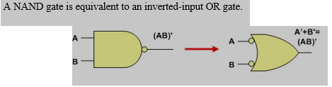

Equivalent Gates
Equivalent gates are those that will generate the same output for a given set of inputs. Important cases of gate equivalence is shown below. Note that bubbles indicate a complement operation (inverter).
An AND gate is equivalent to an inverted-input NOR gate.

Slide 10


A NOR gate is equivalent to an inverted-input AND gate
An OR gate is equivalent to an inverted-input NAND gate.

Slide 11

Two NOT gates in series are same as a buffer because they cancel each other as A’’ = A.

Slide 12
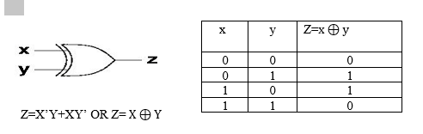

The exclusive-or-gate (XOR)
The exclusive-or-gate is similar to an or-gate. It can have an arbitrary number of inputs, and its output value is 1 if and only if exactly one input is 1 (and thus the others 0). Otherwise, the output is 0. The operator for XOR is ‘ $⊕$’
The logic symbol, Boolean expression and truth table of a two input XOR gate will look like this:

Slide 13
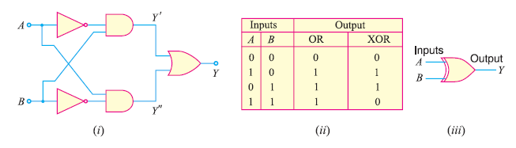
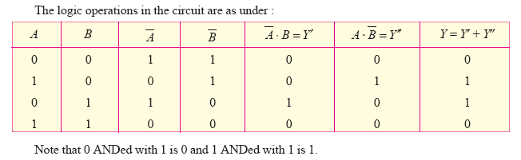
Exclusive OR Gate (X-OR Gate)
Y=A B
Y=A’.B + A.B’

Slide 14

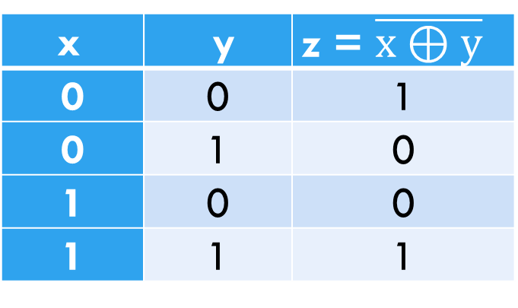
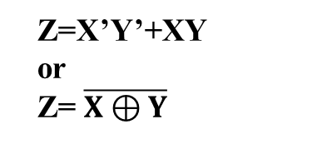
The exclusive-Nor-gate(XNOR)
The exclusive-Nor-gate is similar to an XOR-gate, but its output value is 1 if and only if the two input are of the same values (1 and 1 or 0 and 0). Otherwise, the output is 0.
The logic symbol, Boolean expression and truth table of a two input X-NOR gate will look like this:
x | y | z = $\overline{x⊕y}$
0 | 0 | 1
0 | 1 | 0
1 | 0 | 0
1 | 1 | 1
Z=X’Y’+XY
or
Z= $\overline{X⊕Y}$

Slide 15

Combinational Logic Circuits examples
Session No. 3
An interesting relation between the truth table, Boolean expression and the logic diagram or circuit is that each one can be constructed from the other, i.e. Given the Boolean expression, we can draw the logic diagram and truth table and vice versa, as we will see through the examples.
Draw the logic circuit for the following given Boolean functions
F=A.B+B.C

Slide 16
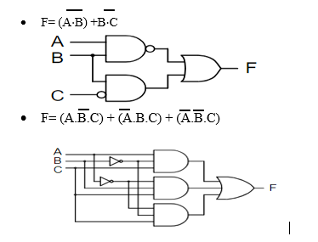

Slide 17
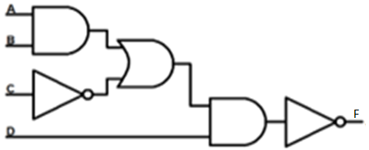
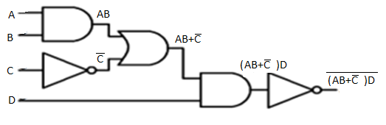
Write the Boolean functions for the given logic circuits.

Slide 18
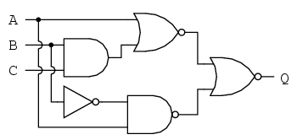
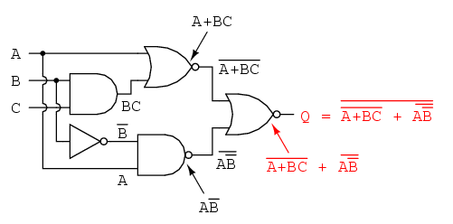
Write the Boolean functions for the given logic circuits.

Slide 19
Boolean algebra
Boolean algebra is used to analyze and simplify the digital (logic) circuits. It uses only the binary numbers i.e. 0 and 1. It is also called as Binary Algebra or logical Algebra.
One of the primary requirements when dealing with digital circuits is to find ways to make them as simple as possible.
This constantly requires that complex logical expressions be reduced to simpler expressions that nevertheless produce the same results under all possible conditions.
The simpler expression can then be implemented with a smaller, simpler circuit, which in turn saves the price of the unnecessary gates, reduces the number of gates needed, and reduces the power and the amount of space required by those gates.

Slide 20
Boolean algebra
One tool to reduce logical expressions is the mathematics of logical expressions, introduced by George Boole in 1854 and known today as Boolean Algebra.
The rules of Boolean Algebra are simple and straight-forward, and can be applied to any logical expression.
The resulting reduced expression can then be readily tested with a Truth Table, to verify that the reduction was valid.
Boolean algebra is an algebraic structure defined on a set of elements B, together with two binary operators (+, . )

Slide 21
BOOLEAN ALGEBRA
Rule Number | Boolean Theorems
1
2
3
4
5
6
7
8
9
10
11
12
Boolean expressions can be simplified using the theorems.
A simplified Boolean expression uses fewest gates possible to implement a given expression.

Slide 22
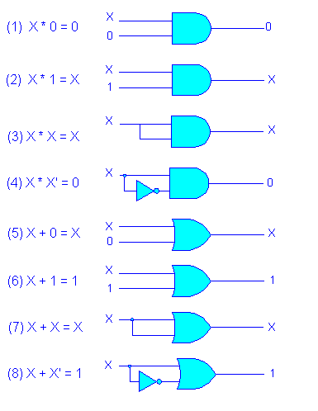
Logical implementation

Slide 23
All these rules can be easily verified using truth tables, and rules 10, 11 and12 are derived. There are two methods by which we can prove the relationships of rules 10, 11 and12. First we use the laws and rules of Boolean algebra. Second we employ the use of truth tables.
Rule 10
Method 1
Method 2
A + AB = A (1+B) | distributive law
= A .1 | rule 2
=A | rule 4
A | B | AB | A + AB
0 | 0 | 0 | 0
0 | 1 | 0 | 0
1 | 0 | 0 | 1
1 | 1 | 1 | 1

Slide 24
Similarly for Rule 12, we can apply the same two methods to prove the relationship.
Method 1
(A + B)(A+C) = AA +AC + BA + BC | distributive law
= A + AC + BA + BC | rule 7
= A (1 + C) + BA + BC | distributive law
= A.1 +BA + BC | rule 2
= A + BA + BC | rule 4
= A (1 + B) + BC | distributive law
= A.1 + BC | rule 2
= A + BC | rule 4
Method 2
A | B | C | A+B | A+C | (A + B)(A+C) | BC | A + BC
0 | 0 | 0 | 0 | 0 | 0 | 0 | 0
0 | 0 | 1 | 0 | 1 | 0 | 0 | 0
0 | 1 | 0 | 1 | 0 | 0 | 0 | 0
0 | 1 | 1 | 1 | 1 | 1 | 1 | 1
1 | 0 | 0 | 1 | 1 | 1 | 0 | 1
1 | 0 | 1 | 1 | 1 | 1 | 0 | 1
1 | 1 | 0 | 1 | 1 | 1 | 0 | 1
1 | 1 | 1 | 1 | 1 | 1 | 1 | 1

Slide 25
EX: Simplify the following expression using Boolean theorems.
Draw the logic diagram of the simplified expression.
AB + A(B + C) + B(B + C)

Slide 26
EX: Simplify the following using Boolean theorems Draw the logic diagram of the simplified expression.
AB + A(B + C) + B(B + C)
Solution
Step 1: Apply the distributive law to the second and third terms in the
expression, as follows: AB + AB + AC + BB + BC
Step 2: Apply rule 7 (BB = B) to the fourth term. AB + AB + AC + B + BC
Step 3: Apply rule 5 (AB + AB = AB) to the first two terms. AB + AC + B + BC
Step 4: Apply rule 10 (B + BC = B) to the last two terms. AB + AC + B
Step 5: Apply rule 10 (AB + B = B) to the first and third terms. B+AC
At this point the expression is simplified as much as possible.

Slide 27
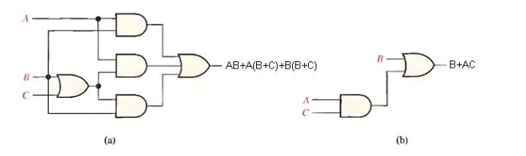
Original expression
simplified expression

Slide 28
Multivariable Theorems
1 x + y = y + x (commutative law)
2 x * y = y * x (commutative law)
3 x+ (y+z) = (x+y) +z = x+y+z (associative law)
4 x (yz) = (xy) z = xyz (associative law)
5 x (y+z) = xy + xz (distributive law)
6 (w+x)(y+z) = wy + xy + wz + xz (distributive law)
x + xy = x (Absorption)
x(x + y) = x (Absorption)
Two Variable De Morgan's theorems
(I) (x+y)' = x' * y'
(II) (x*y)' = x' + y‘
Three Variables De Morgan's Theorem
(x+y+z)' = x' * y' * z'
(xyz)' = x' + y' + z'
DE MORGAN'S THEOREM

Slide 29
Implications of De Morgan's Theorem
The objective of using these theorems in circuit design is to minimize the number of IC’s required in a logic circuit.
Example: Prove that,
[(A'+C) * (B+D')] ' =AC' + B'D
X | = [(A'+C) * (B+D')]'
 | = (A'+C)' + (B+D')' [by theorem (II)]
 | = (A''*C') + (B'*D'') [by theorem (I)]
 | = AC' + B'D

Slide 30
Problem Solving
Apply Demorgan’s theorem to the following expressions and simplify:
1.
2.

Slide 31
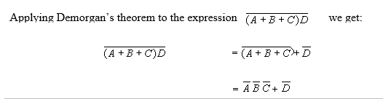
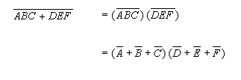
Problem Solving
Apply Demorgan’s theorem to the following expressions and simplify:
1.
2.

Slide 32
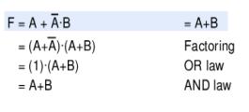
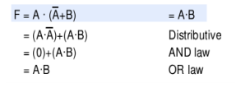
More examples Prove that
Pg 26: a+bc=(a+b)(a+c)

Slide 33
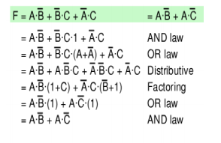

Slide 34
Simplify the following using Boolean properties/DE MORGAN’s THEOREMS
F = (ABC)’ + (A’BC) + (AC)’
F = (A+B+C)(A+B+C’)(A+C’)

Slide 35
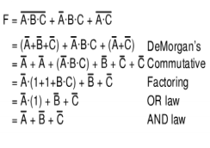
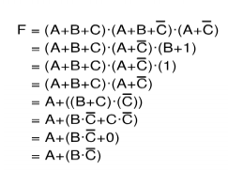
Simplify the following using Boolean properties/DE MORGAN’s THEOREMS
Pg 26: a+ab=a
a(a+b)=a

Slide 36
Simplify the following using Boolean properties/De Morgan’s THEOREMS
F = (A’ + B’)’ + (A + B)’ + (A + B’)’
F = (A ^ B) + (A ^ B’)

Slide 37
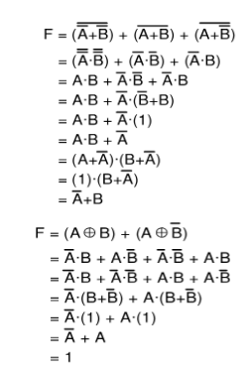
Simplify the following using Boolean properties

Slide 38
Reference:
https://cupola.gettysburg.edu/cgi/viewcontent.cgi?article=1000&context=oer

